Slide 1
Primary Live!
FOCUS ON STRINGS

Slide 2
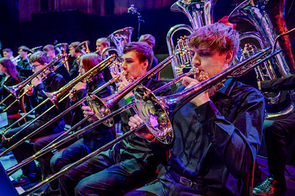
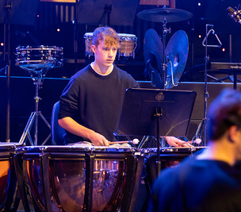
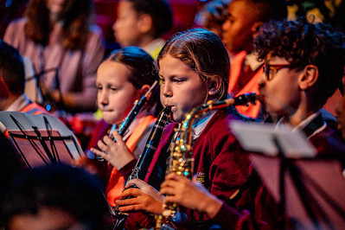
Families of Instruments in an Orchestra
Brass
Strings
Percussion
Woodwind
Photo Credits: Laura Palmer

Slide 3
Listen, then watch
What family of instruments do these pieces of music have in common? LISTEN FIRST, THEN SHOW THE VIDEOS
Air on a G String by Bach
Flight of the Bumblebee by Nikolai Rimsky-Korsakov
Palladio by Karl Jenkins
The Lark Ascending by Ralph Vaughan Williams

Slide 4
The String Instrument Family
Visit this BBC Teach site to learn more about each member of the String family:
Learn about the stringed instruments of the orchestra - BBC Teach
Photo Credit: Laura Palmer

Slide 5
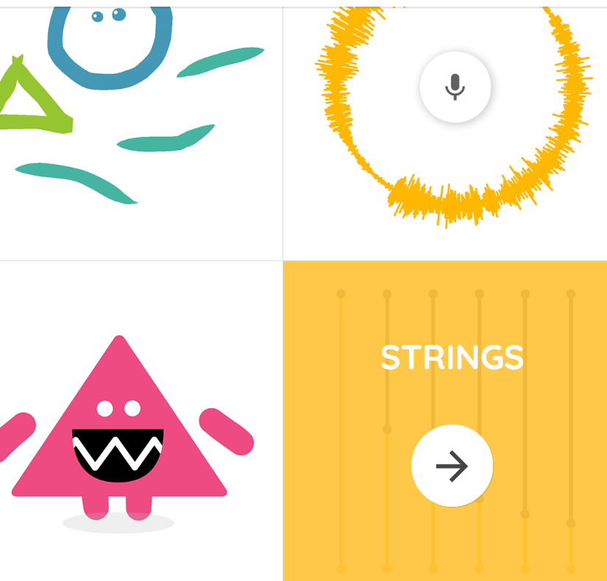
discover
Try this Chrome Music Lab* experiment.
Discover how the musicians finger placement on the strings of an instrument creates different pitches (notes)
Chrome Music Lab - Strings (chromeexperiments.com)
True or False?
The longer the string the higher the pitch
The shorter the string, the higher the pitch
*Chrome Music Lab is a free website resource provided by Google. It has a selection of
tools and experiments which help to make connections between music, maths, and science.

Slide 6
Quiz Strings | London Symphony Orchestra (lso.co.uk) Using the London Symphony Orchestra’s Learn and Discover resource, LISTEN and guess which string instrument is being played. WATCH the clips to discover the answers
1
2
3
4

Slide 7
PrimaRy Live!
In association with

