Slide 1
Primary live!
FOCUS ON MUSICAL THEATRE

Slide 2
SONGS
Rather than just telling a story through words, in a musical, the songs are there to help us understand more about what a character is feeling.
Listen to Tim Minchin the composer talk about writing the songs in Matilda
Music Tim Minchin - YouTube
(short version: watch from 6:09 – 9:34)
Click the picture to listen to the song’ Revolting Children’ from Matilda the Musical
What are the children feeling?
Can you explain your answer?

Slide 3
COMPOSE
Listen to this
MARCH for inspiration:
In groups, write Miss Trunchbull’s
School March
for the children at Cruncham Elementary School
to walk into their classrooms.
You will:
CREATE A RHYTHM
WRITE A MELODY
and if you’re feeling really confident…
PLAY WITH DIFFERENT DYNNAMICS AND TEMPO
Remember the Headmistress is very mean!

Slide 4
Rhythm
Use percussion instruments to create your marching rhythm
Click on the picture to use Google’s Chrome Music Lab
to experiment

Slide 5
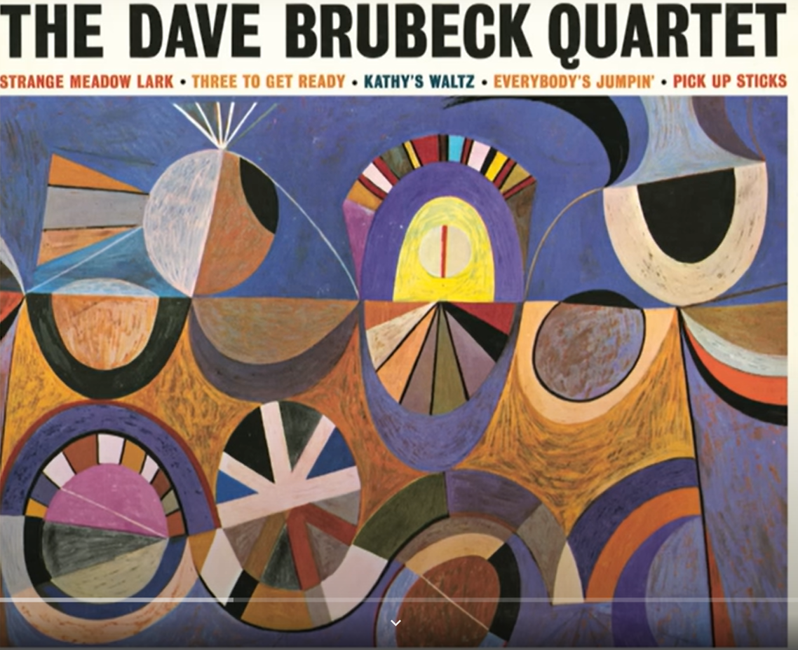
Melody
Visit this BBC Bitesize page to find out more…
Use your keyboard / glockenspiel or xylophone to create a melody.
Decide on a short melody which conveys the correct emotion.
What pitch will you choose?
(high notes or low notes?)
KS2 Extension: create an ostinato
(a repeating pattern)
Here is an example of a famous ostinato

Slide 6
Dynamics
Tempo
Will you choose to play
fast or slow?
Try out both, then try playing some parts fast and some parts slow
Will you choose to play
quietly or loudly?
Try out both, then try playing some parts quietly and some parts loudly
loud
slow
quiet
fast

Slide 7
PERFORM
Perform your School March!

Slide 8
PrimaRy Live
In association with

