Slide 1
PRIMARY LIVE!
FOCUS ON CARNATIC MUSIC

Slide 2
CARNATIC MUSIC
Carnatic music is South Indian Classical Music.
It has been practiced for centuries and has a rich history.

Slide 3
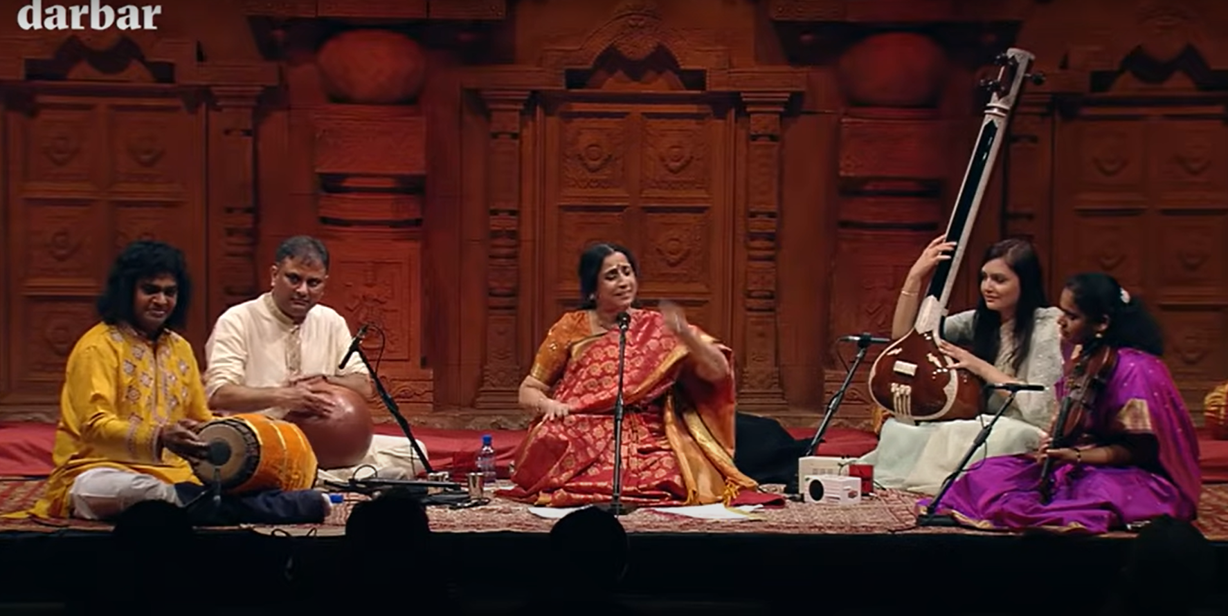
KEY FEATURES
The Key Features
Drone
Vocals
Rhythm
Improvisation (keeping within the rhythmic cycles)
Watch the video above and see if you can identify each feature…

Slide 4
Rhythm
Rhythm in music refers to the pattern of sounds and silences that occur over time. It is sometimes described as the ‘heartbeat’ or ‘pulse’ of a piece of music.
Voice and Rhythm are very important in Carnatic Music.
The rhythm patterns can be complicated.
You will often see the singers count the rhythm with their hands (tala), almost all the way through each piece of music.
Play the clip of Harrow Tamil Association Orchestra, playing at Harrow Arts Centre, to see this in action…

Slide 5
Mridangam
Draw the Mridangam and label the different parts.
Use these words:
strap, black spot, bass, wood
Is a double ended drum
One end has a black spot – this plays higher notes than the white end which plays bass (low) notes
It is made of wood, and held together with straps
There are 6 different types of hand stroke with which the musician can hit the drum, but many, many different combinations!
The patterns and rhythms played can be very complicated and take many years to learn

Slide 6
WATCH
Watch the Mridangam being played by clicking on the picture.
Can you see what the singer is doing with her hands?

Slide 7
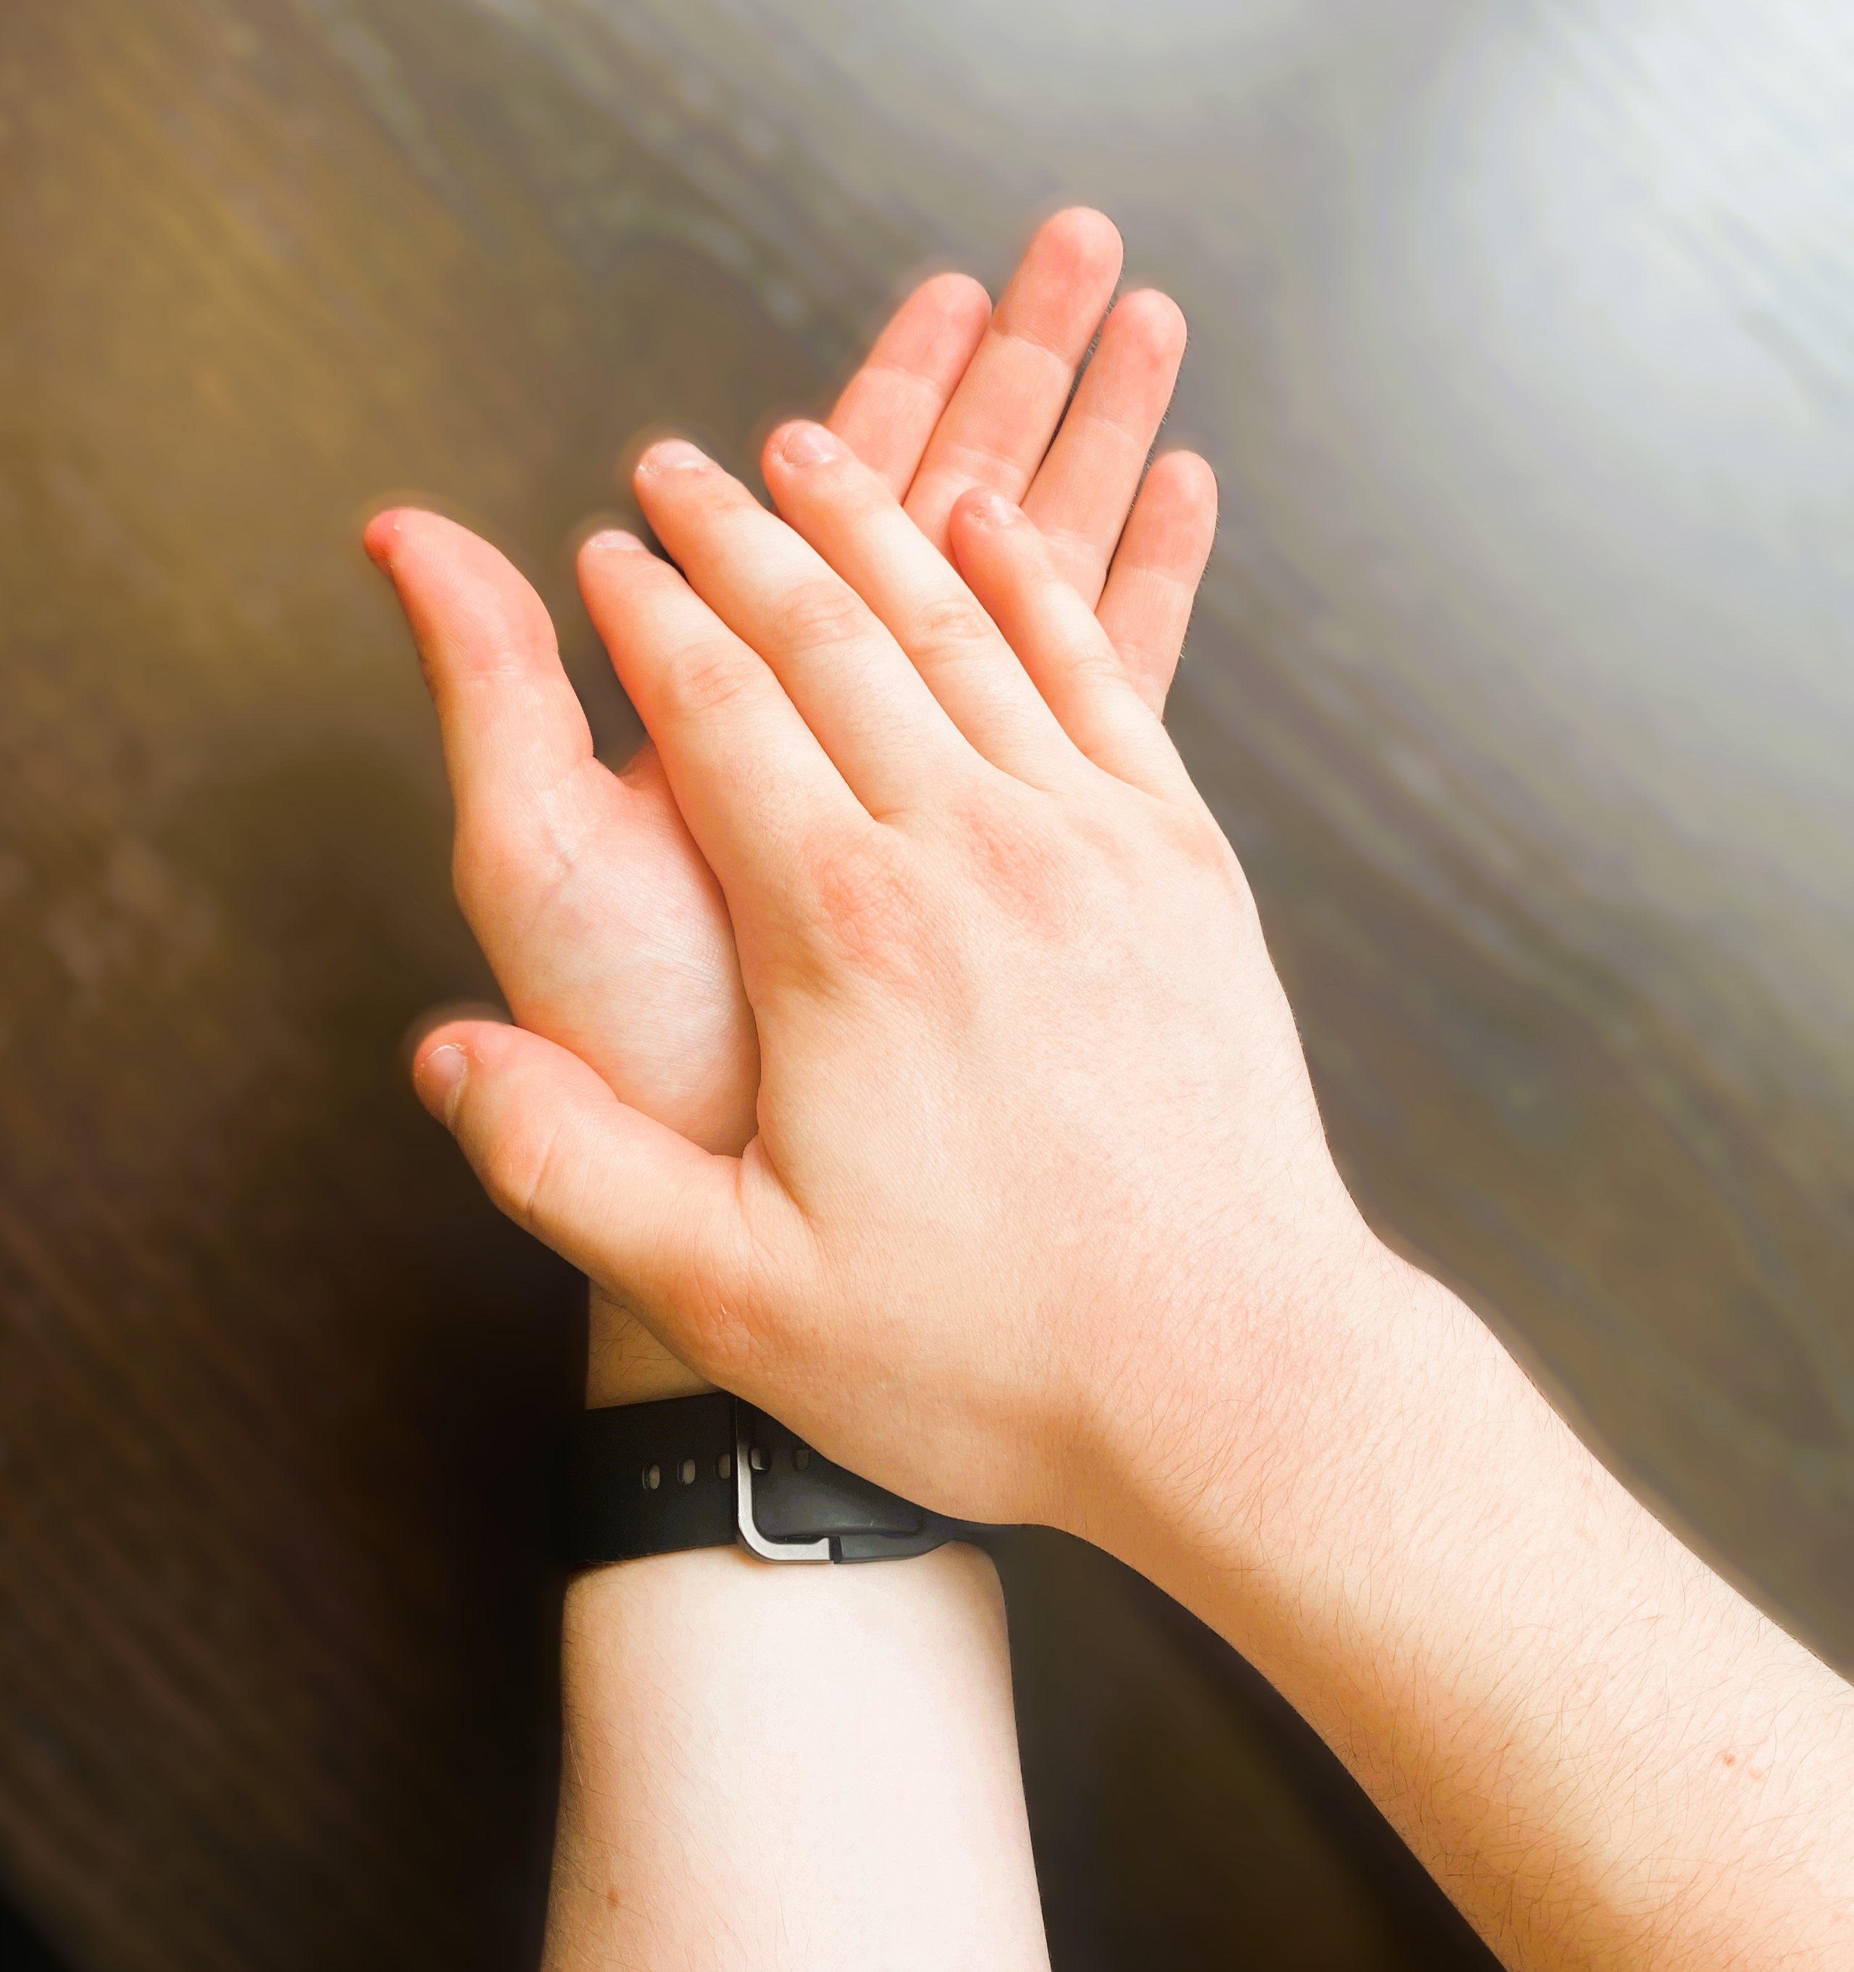
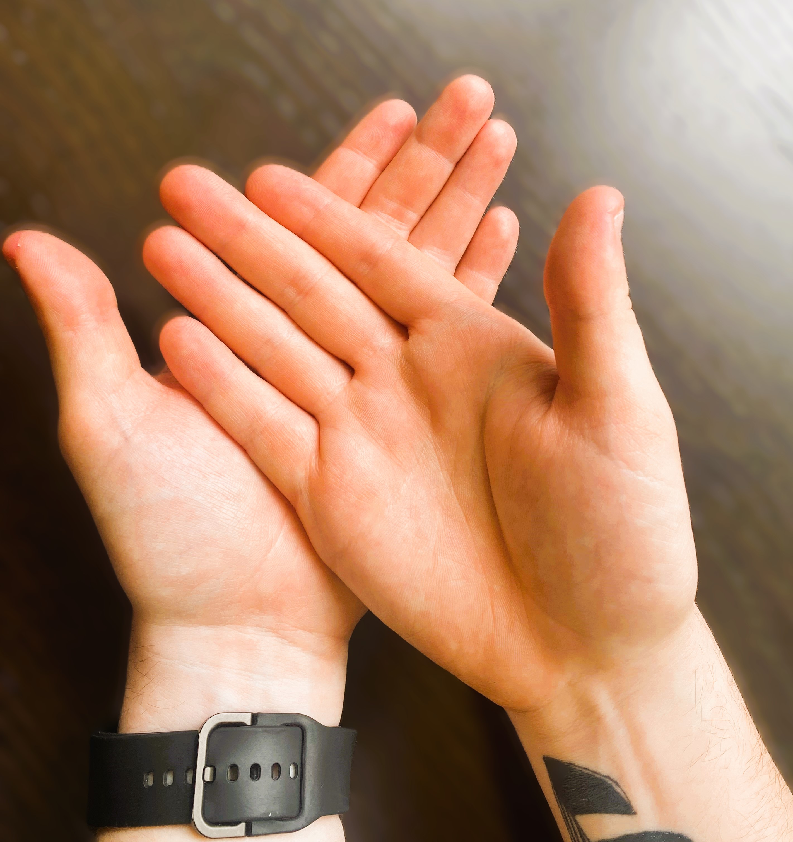
Counting Tala Very simply, this is the way Carnatic Musicians count musical time. Different hand claps keep track of the rhythm. For example: if you watch the previous video, you can see the singer counting a rhythm of 3 beats:
TRY IT – repeat X 4 | Clap | Clap | Wave
3 beat rhythm cycle
Now try another rhythm…

Slide 8
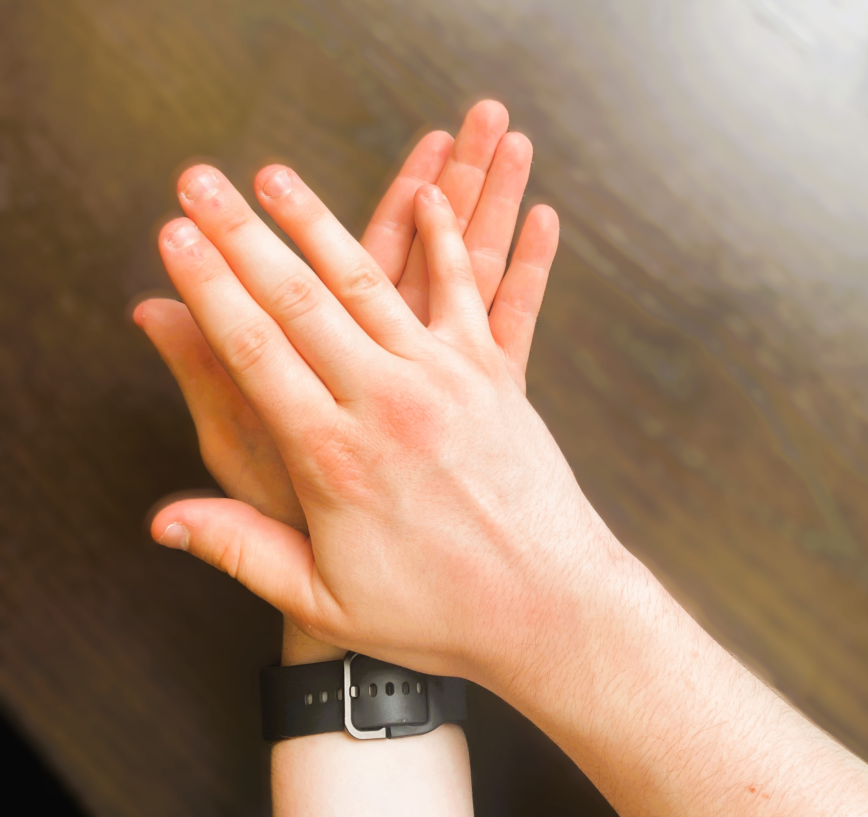
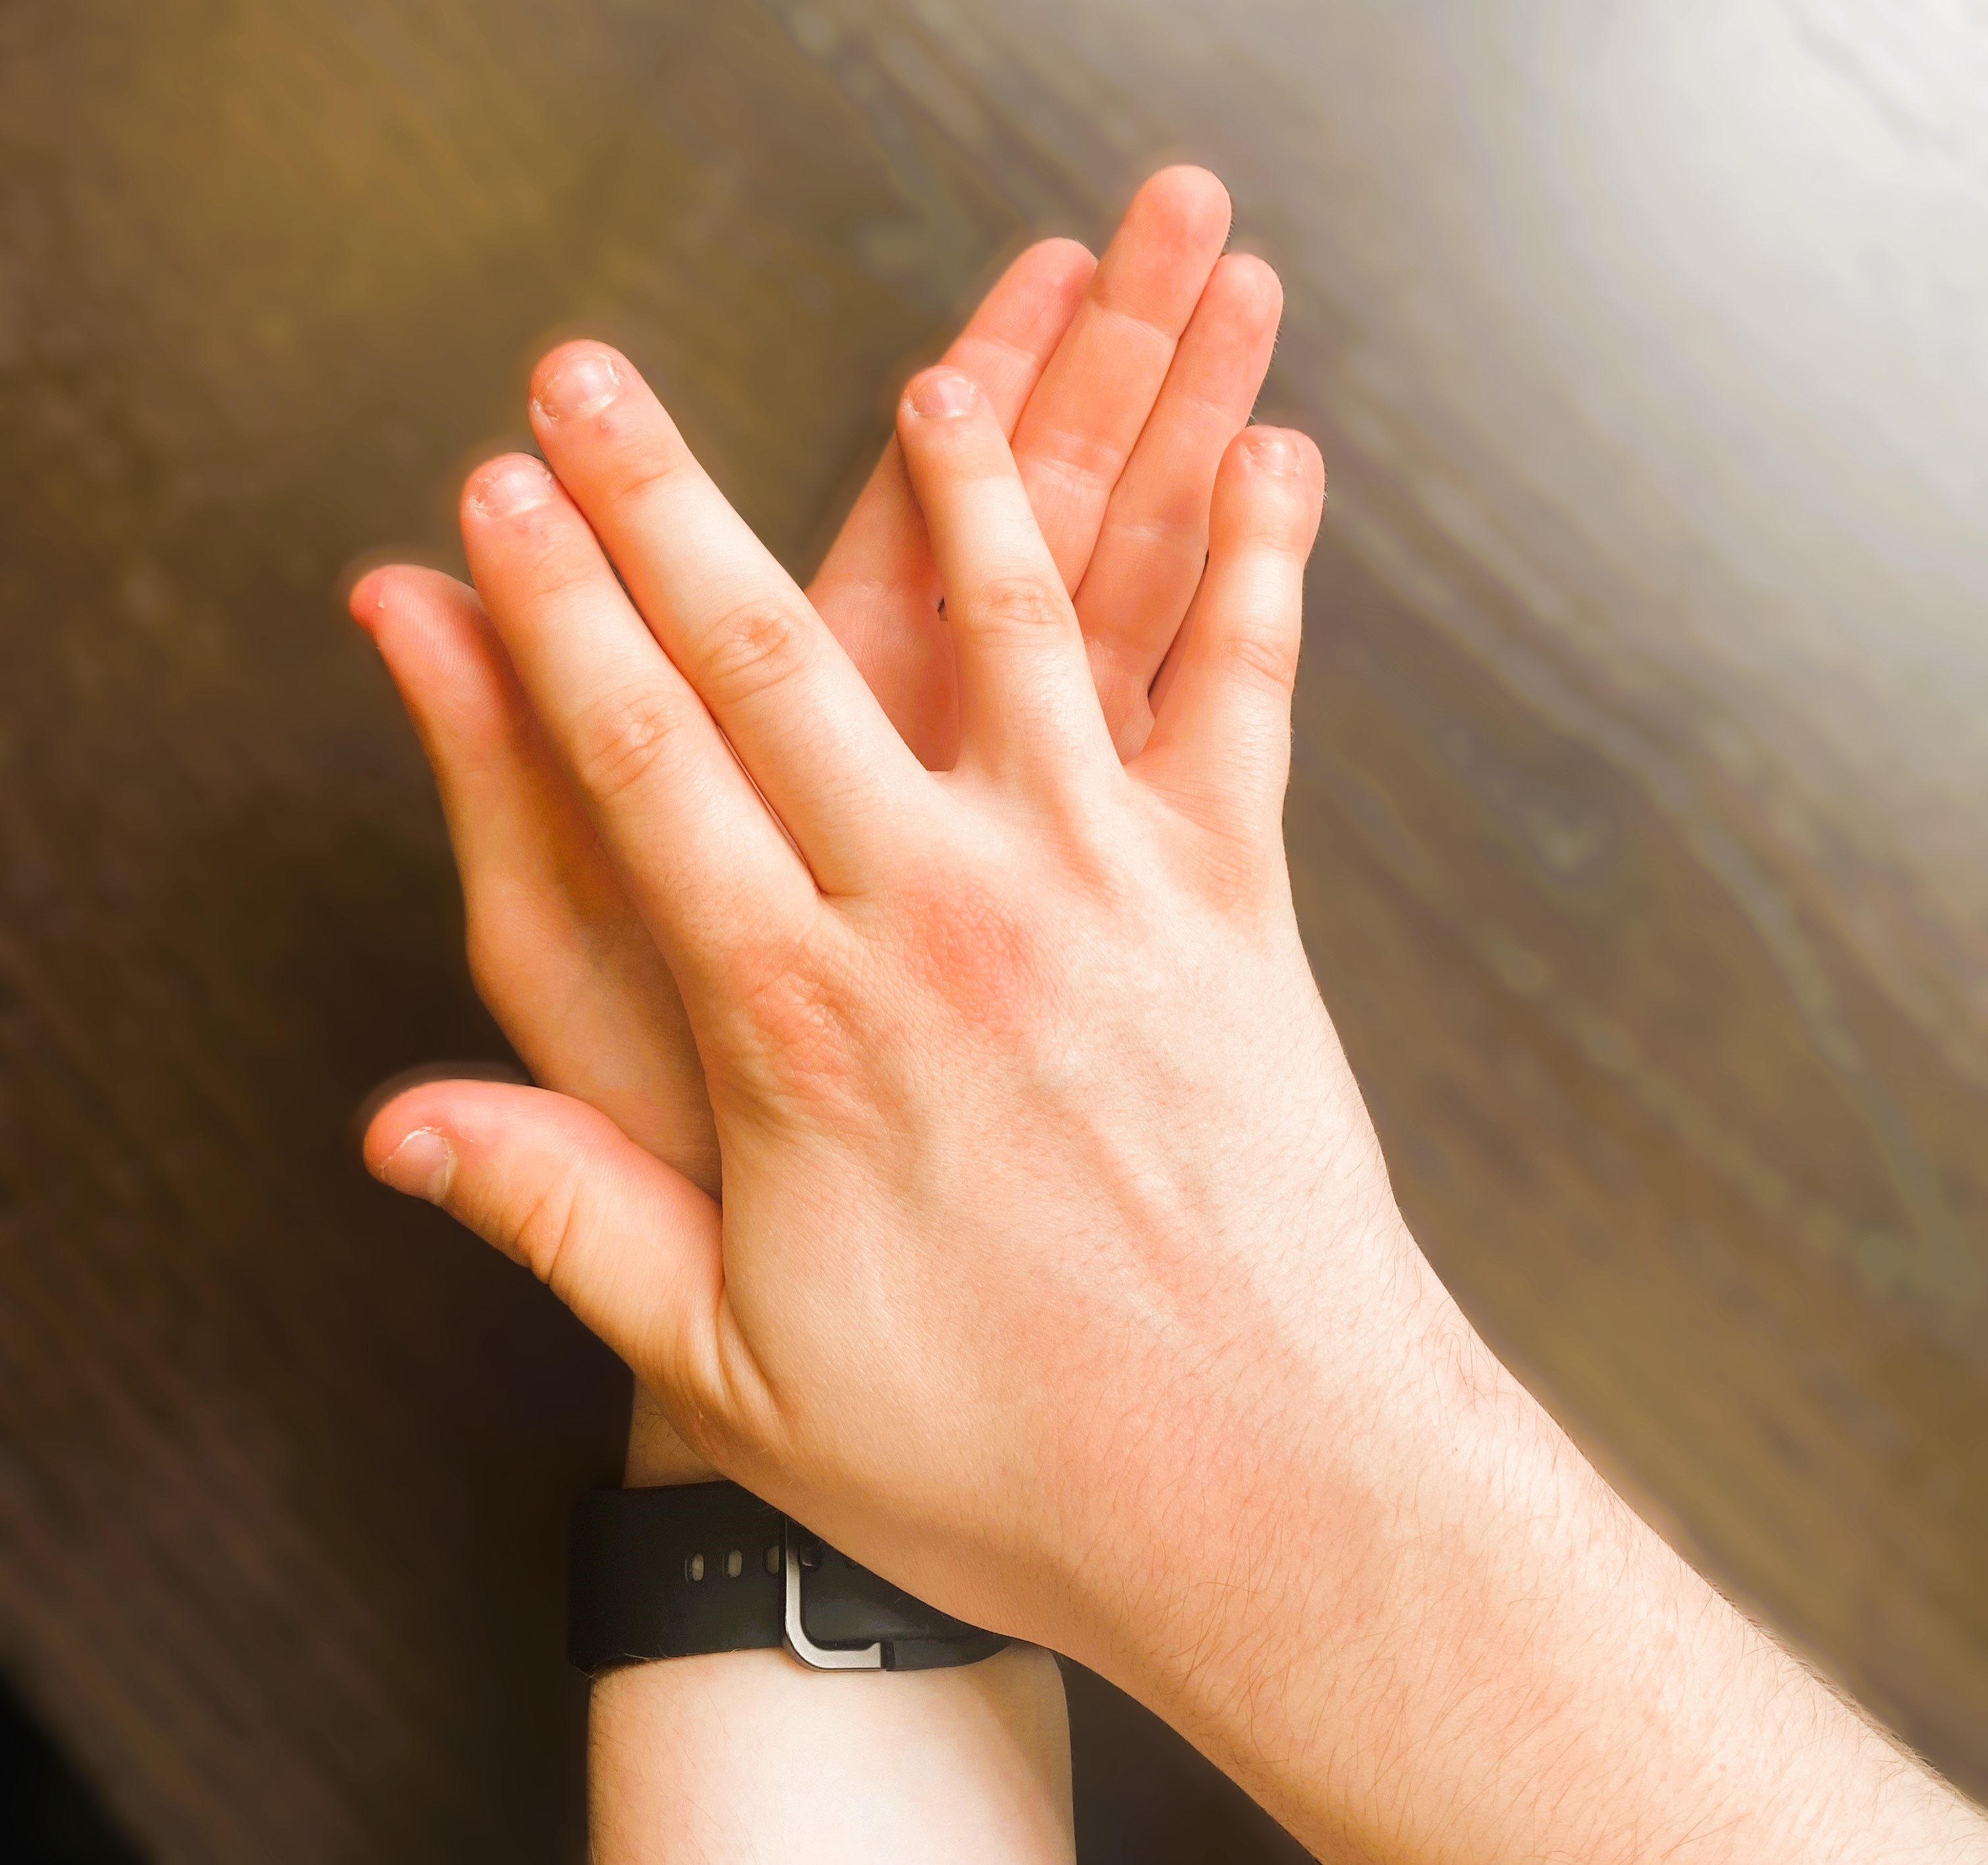
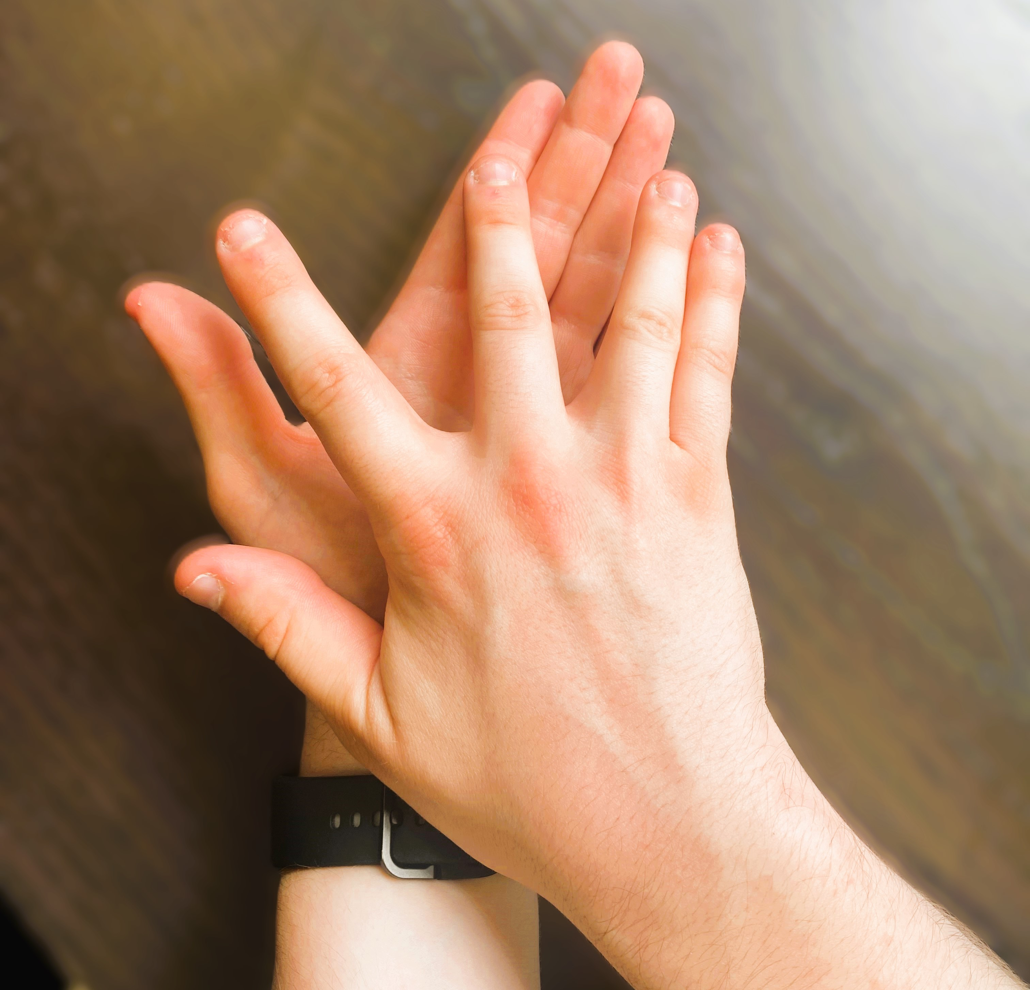
ADI TALA (8 Beat Rhythm Cycle)
DIFFERENTIATION:
To make the rhythm easier, create a 4 Beat Rhythm Cycle - focus ONLY on actions 5, 6, 7, 8
Some music to practice with
1. CLAP | 2. PINKY FINGER | 3. RING FINGER | 4. MIDDLE FINGER
5. CLAP | 6. WAVE | 7. CLAP | 8. WAVE

Slide 9
PrimaRy Live!
In association with

