Slide 1
PRIMARY LIVE!
FOCUS ON FILM MUSIC

Slide 2
WHY DO FILMS USE MUSIC?
Click on the picture to watch the opening scene from The Lion King, played with 5 different soundtracks.
Does the different music affect the feel of the scene?
VOCABULARY YOU COULD USE:
funny, sad, mysterious, powerful, heroic, joyful, serious, silly, majestic

Slide 3
Hero or Villain?
Click on each picture to listen to a theme tune.
Is it the theme tune to a hero or a villain?
FREEZE THE SCREEN SO AS NOT TO GIVE THE GAME AWAY!

Slide 4
Composing
We are going to compose our own hero or villain theme or Leitmotif (that’s the proper musical name).
You will need an instrument with notes for example: a Keyboard, a Xylophone, or a Glockenspiel

Slide 5
SSSH! A TRICK to help you sound like a hero
A – B – C – D – E – F - G
Lots of HERO leitmotifs, use the interval of a fifth.
Simply put, this means, the notes are 5 notes apart.
An easy way to work this out is to hold out your right hand and count from your thumb
(Musical notes range from A to G):
A – B – C – D – E
1 – 2 – 3 – 4 – 5
Listen to this ‘hero leitmotif’ which uses just the notes A and E

Slide 6
A TRICK! to help you sound like a villain!
One of the ways you can create an evil sounding villain leitmotif is by using the black and white notes on the keyboard which are next to each other:
Chromatic notes
Listen to an example here:

Slide 7
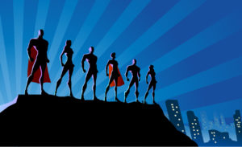
Hero or villain? compose your leitmotif
Subtitle

Slide 8
PrimaRy Live!
In association with

